Slide 1

Polar Bonds and Polar Molecules
The Impact of Electronegativity

Slide 2
Intramolecular Bonds
(Bonds Between Atoms)
Ionic
Covalent
Polar
Nonpolar

Slide 3
Learning Goals
I will be able to explain the difference between polar bonds and polar molecules
I will be able to explain how polarity impacts the behavior of a substance.

Slide 4


Slide 5
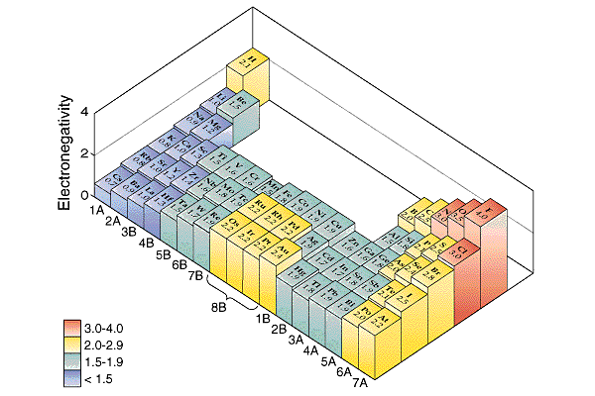
Bond Polarity and Electronegativity
Electronegativity: The ability of one atoms in a molecule to attract electrons to itself.
Pauling set electronegativities on a scale from 0.7 (Cs) to 4.0 (F).
Electronegativity increases
across a period and
up a group.

Slide 6
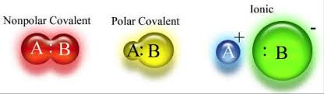
Electronegativity
A non-polar bond or molecule has an equal sharing of the electrons.
A polar bond or molecule has an unequal sharing of the electrons.

Slide 7

The electron clouds of a non-polar and polar covalent molecule (only two atoms, therefore only one bond shown).
http://hfs.ncvps.org/Curriculum/APChemistry/ModuleFive/BondingLesson/APChem_Bonding_ToGo4.html

Slide 8
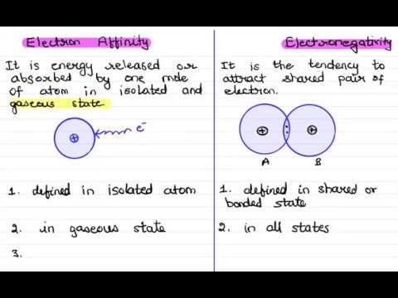
DO NOT GET THESE CONFUSED
Electron Affinity
Electronegativity
Electron affinity is the amount of energy released when a neutral atom or molecule gains an electron.
Quantitative Property
Measured in units like kJ/mol
Defined in isolated and gaseous state.
Electronegativity is the ability of an atom to attract electrons from outside.
Qualitative Property
Measured on a scale (no real units).
Defined in shared or bonded state.

Slide 9
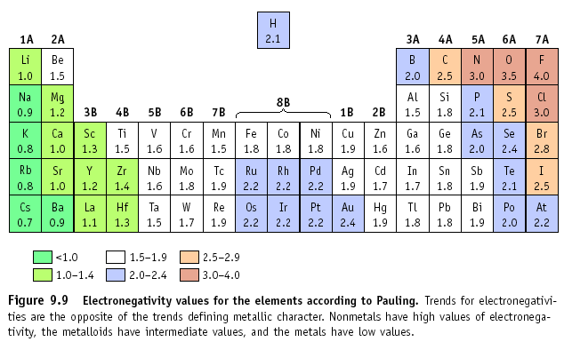
Determining the polarity of a bond
Look up the electronegativities of each element
Subtract the smaller number from the bigger number
If the difference in electronegativities is between:
1.7 to 4.0: Ionic
0.41 to 1.7: Polar Covalent
0.0 to 0.4: Non-Polar Covalent
Example: NaCl
Na = 0.9, Cl = 3.0
Difference is 2.1, so
this is an ionic bond!

Slide 10
Is the sharing of electrons in molecules always equal?
non-polar bond
X
Y
ΔEN = 0
Which element is more electronegative?
X
Y
ΔEN = 0.5
X
Y
ΔEN = 0.6
EN_{Y} > EN_{X}
increasing polarity of bond
polar bond
X
Y
ΔEN = 0.9
0.4 < EN < 1.7
Ionic bond
X
2+
Y
2-
ΔEN = 1.9
Direction of electron migration

Slide 11
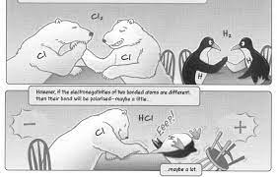
Non-Polar Covalent Bonds
Examples:
All diatomic molecules
(ie: Cl₂, H₂)
What is non-polar covalent?
-Non polar covalent is a covalent bond that has an even distribution of charge due to an equal sharing of bonding electrons.

Slide 12
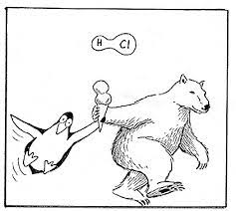
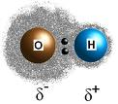
Polar Covalent Bonds
What is polar covalent?
-Polar covalent is a description of a bond that has an uneven distribution of charge due to an unequal sharing of bonding electrons.

Slide 13
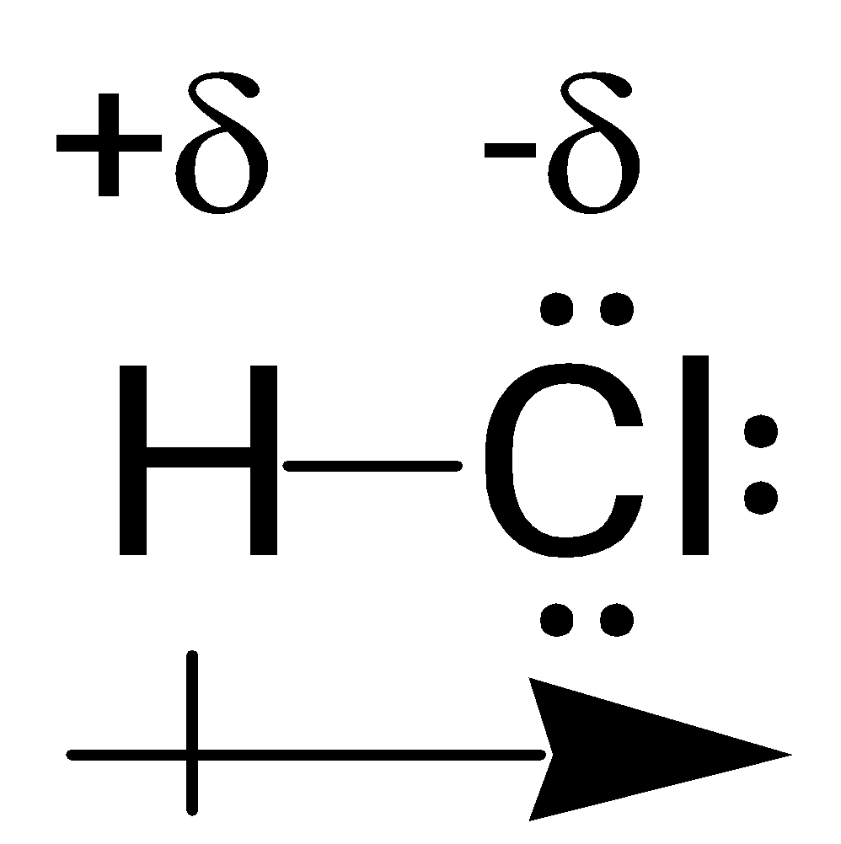
Polar Covalent Bonding
Example: HCl
H = 2.1, Cl = 3.0
Difference is 0.9, so
this is an polar covalent bond!
Cl has a greater electronegativity than H, and therefore, pulls the electrons in the shared bond towards itself.
Cl has slight negative charge (-δ) and H has slight positive charge (+ δ)

Slide 14
Polar Molecules…
Draw the Lewis diagram of the molecule
In order to be a polar molecule, it MUST CONTAIN POLAR BONDS!!!!
And it must be an asymmetrical molecule. Which means it has a positive end and a negative end

Slide 15
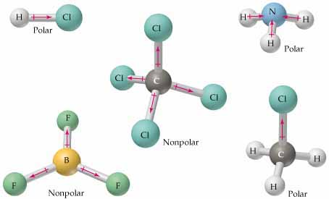
Polar Molecules
Note: Not all molecules with polar bonds are polar molecules

Slide 16
Significance of Molecular Polarity
Why is polarity of the whole molecule so important?
Many physical properties of substances (ie: state at SATP, melting and boiling points, solubility) are affected by the polarity of their molecules, not just their intramolecular bonds

Slide 17

Why do we care?
A polar substance will only mix with another polar substance.
A non-polar substance will only mix with another non-polar substance.
Polarity also affects properties such as melting point.

Slide 18
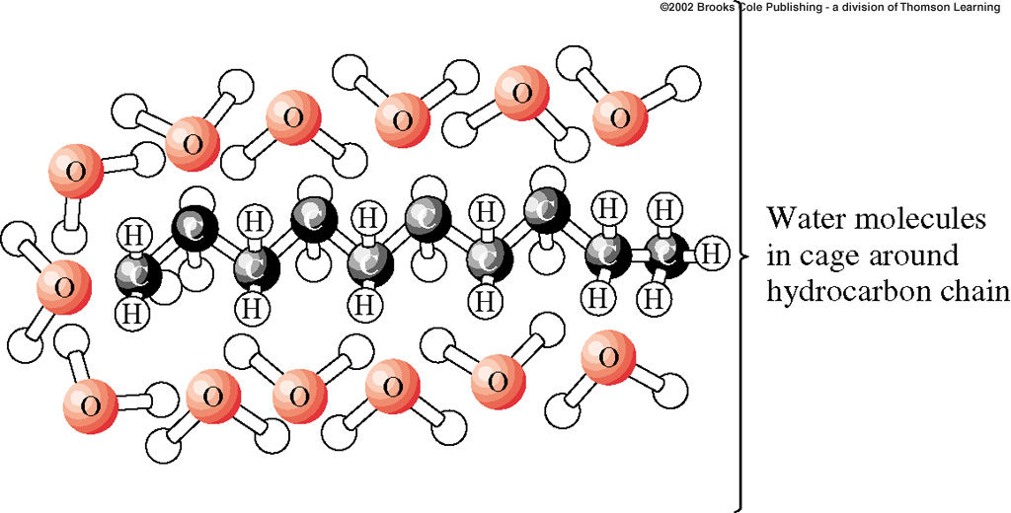
Bond Polarity
This is why oil and water will not mix! Oil is nonpolar, and water is polar.
The two will repel each other, and so you can not dissolve one in the other

Slide 19
LET’S TRY
Try These bonds, their EN difference & bond type. Compare with a partner.
1.Li and Cl
(1.0 & 3.0)
2. N & N (# bonds formed? Doesn’t change EN why?)

Slide 20
For N & N, a triple bond is formed but you do NOT multiply electronegativity because its a measure of the nucleus’ attraction for electrons and therefore the number of bonds between two atoms isn’t relevant to the electronegativity difference and type of bond formed.

Slide 21
Try these:
Be & N
(1.5& 3.0)
P & F (what kind of bond would you expect, 2 non-metals)
(2.1& 4.0)

Slide 22
P & F -> you would expect a covalent bond
(2.1& 4.0) but the electronegativity difference indicates its ionic.
In this case, in the context of a whole molecule (more than one fluorine etc) the bond would just be highly polar rather than ionic, because it is TWO NON-METALS still. For assessments, you would indicate the electronegativity difference falls in the ionic range but you should be able to explain why the molecule has polar properties (difference is just a GUIDELINE).

